Slide 1
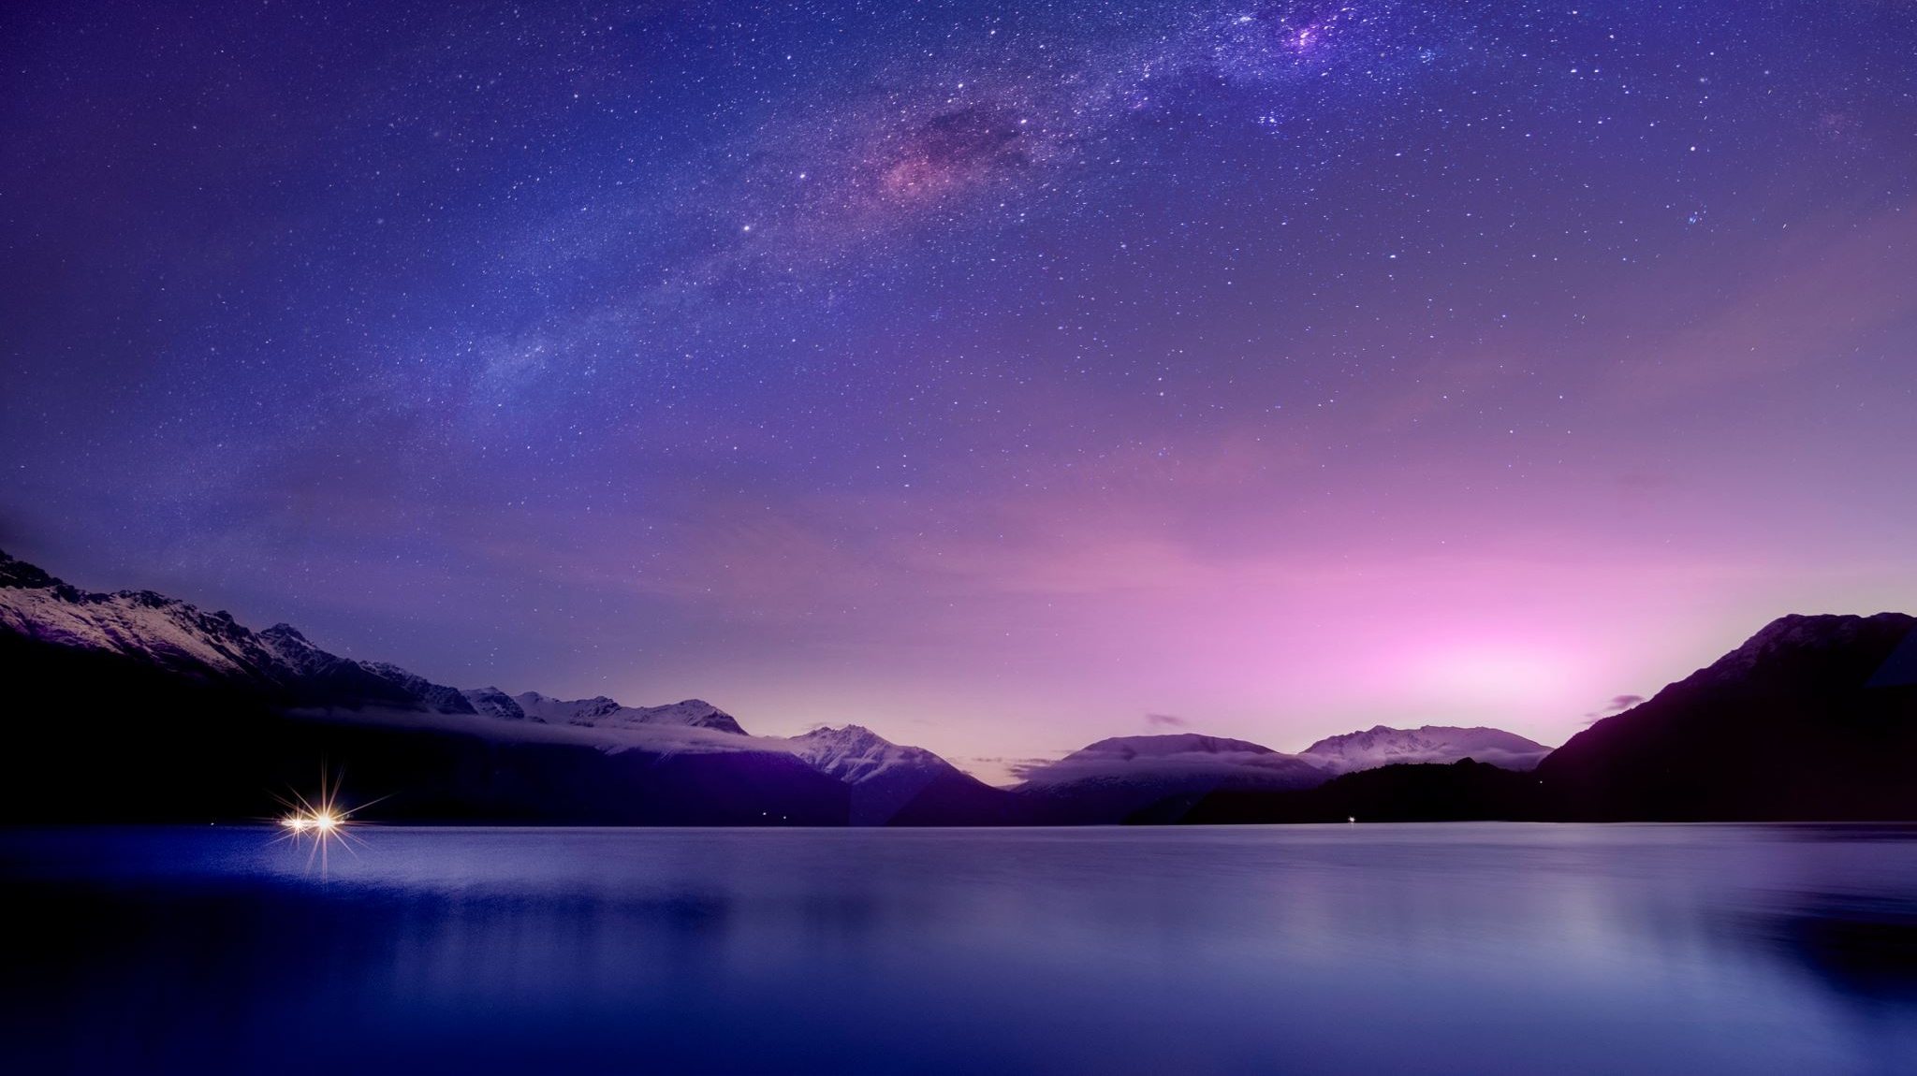
Hubble at 35: the Eighth Wonder of the World
Brad Young, Astronomy Club of Tulsa

Slide 2
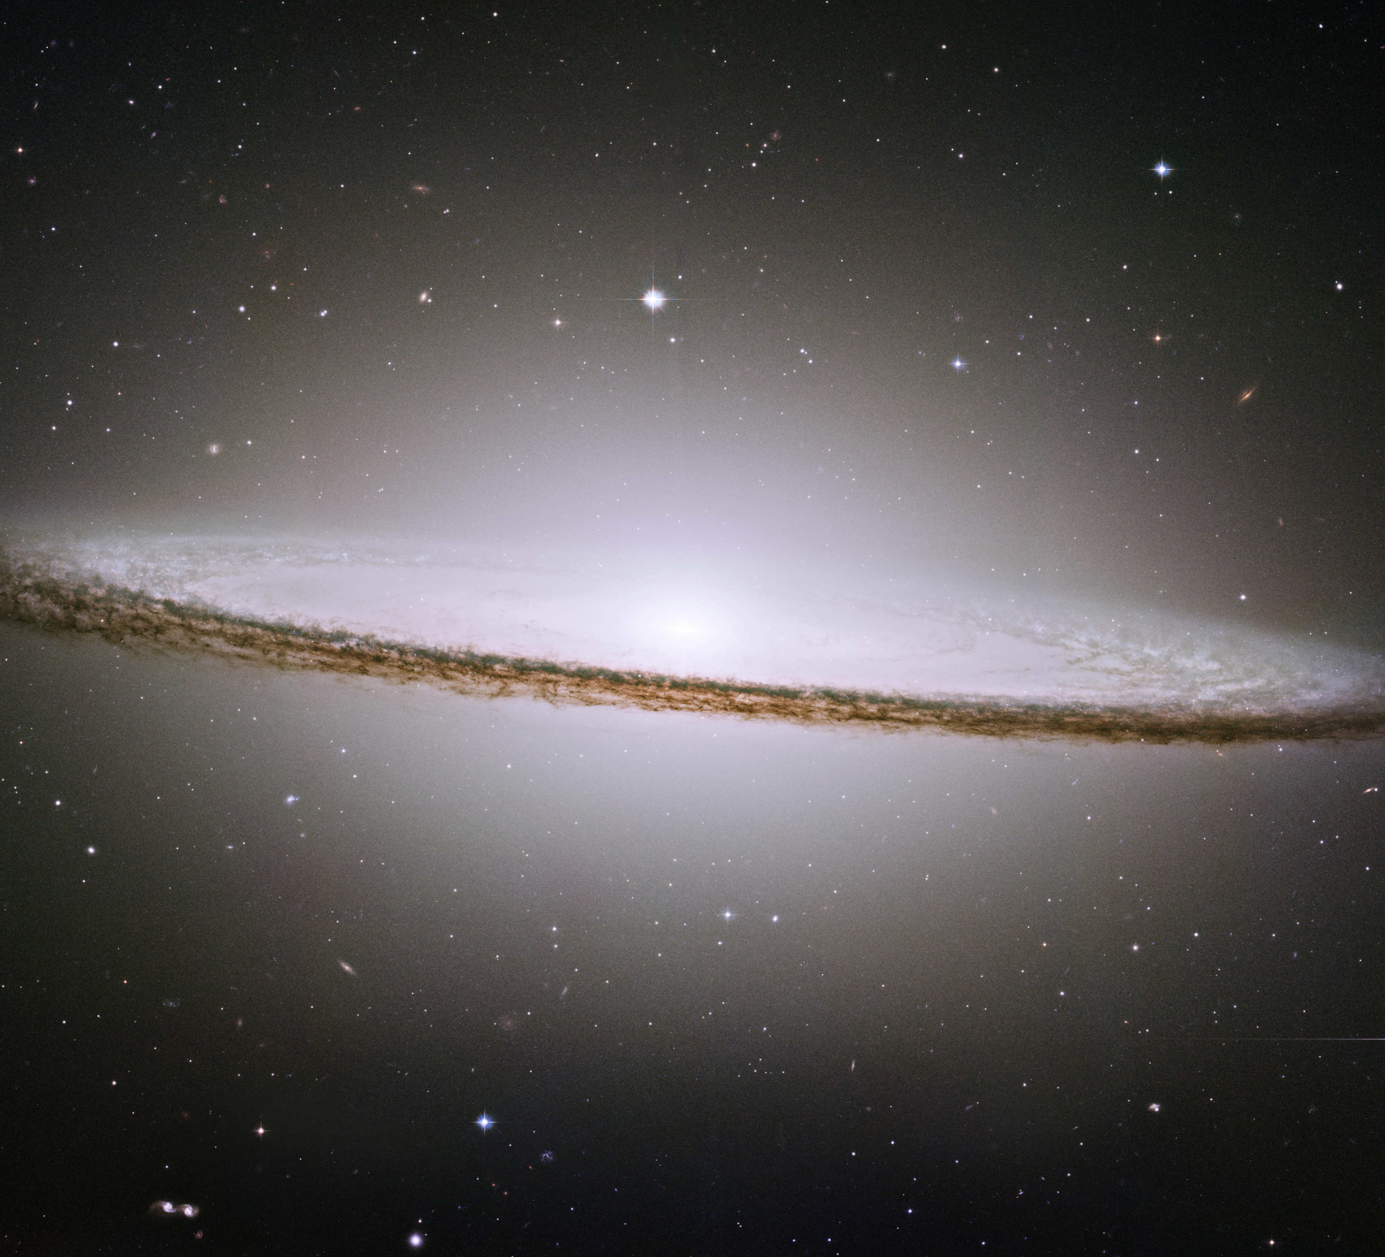
Hubble Space Telescope changed astronomy forever

Slide 3
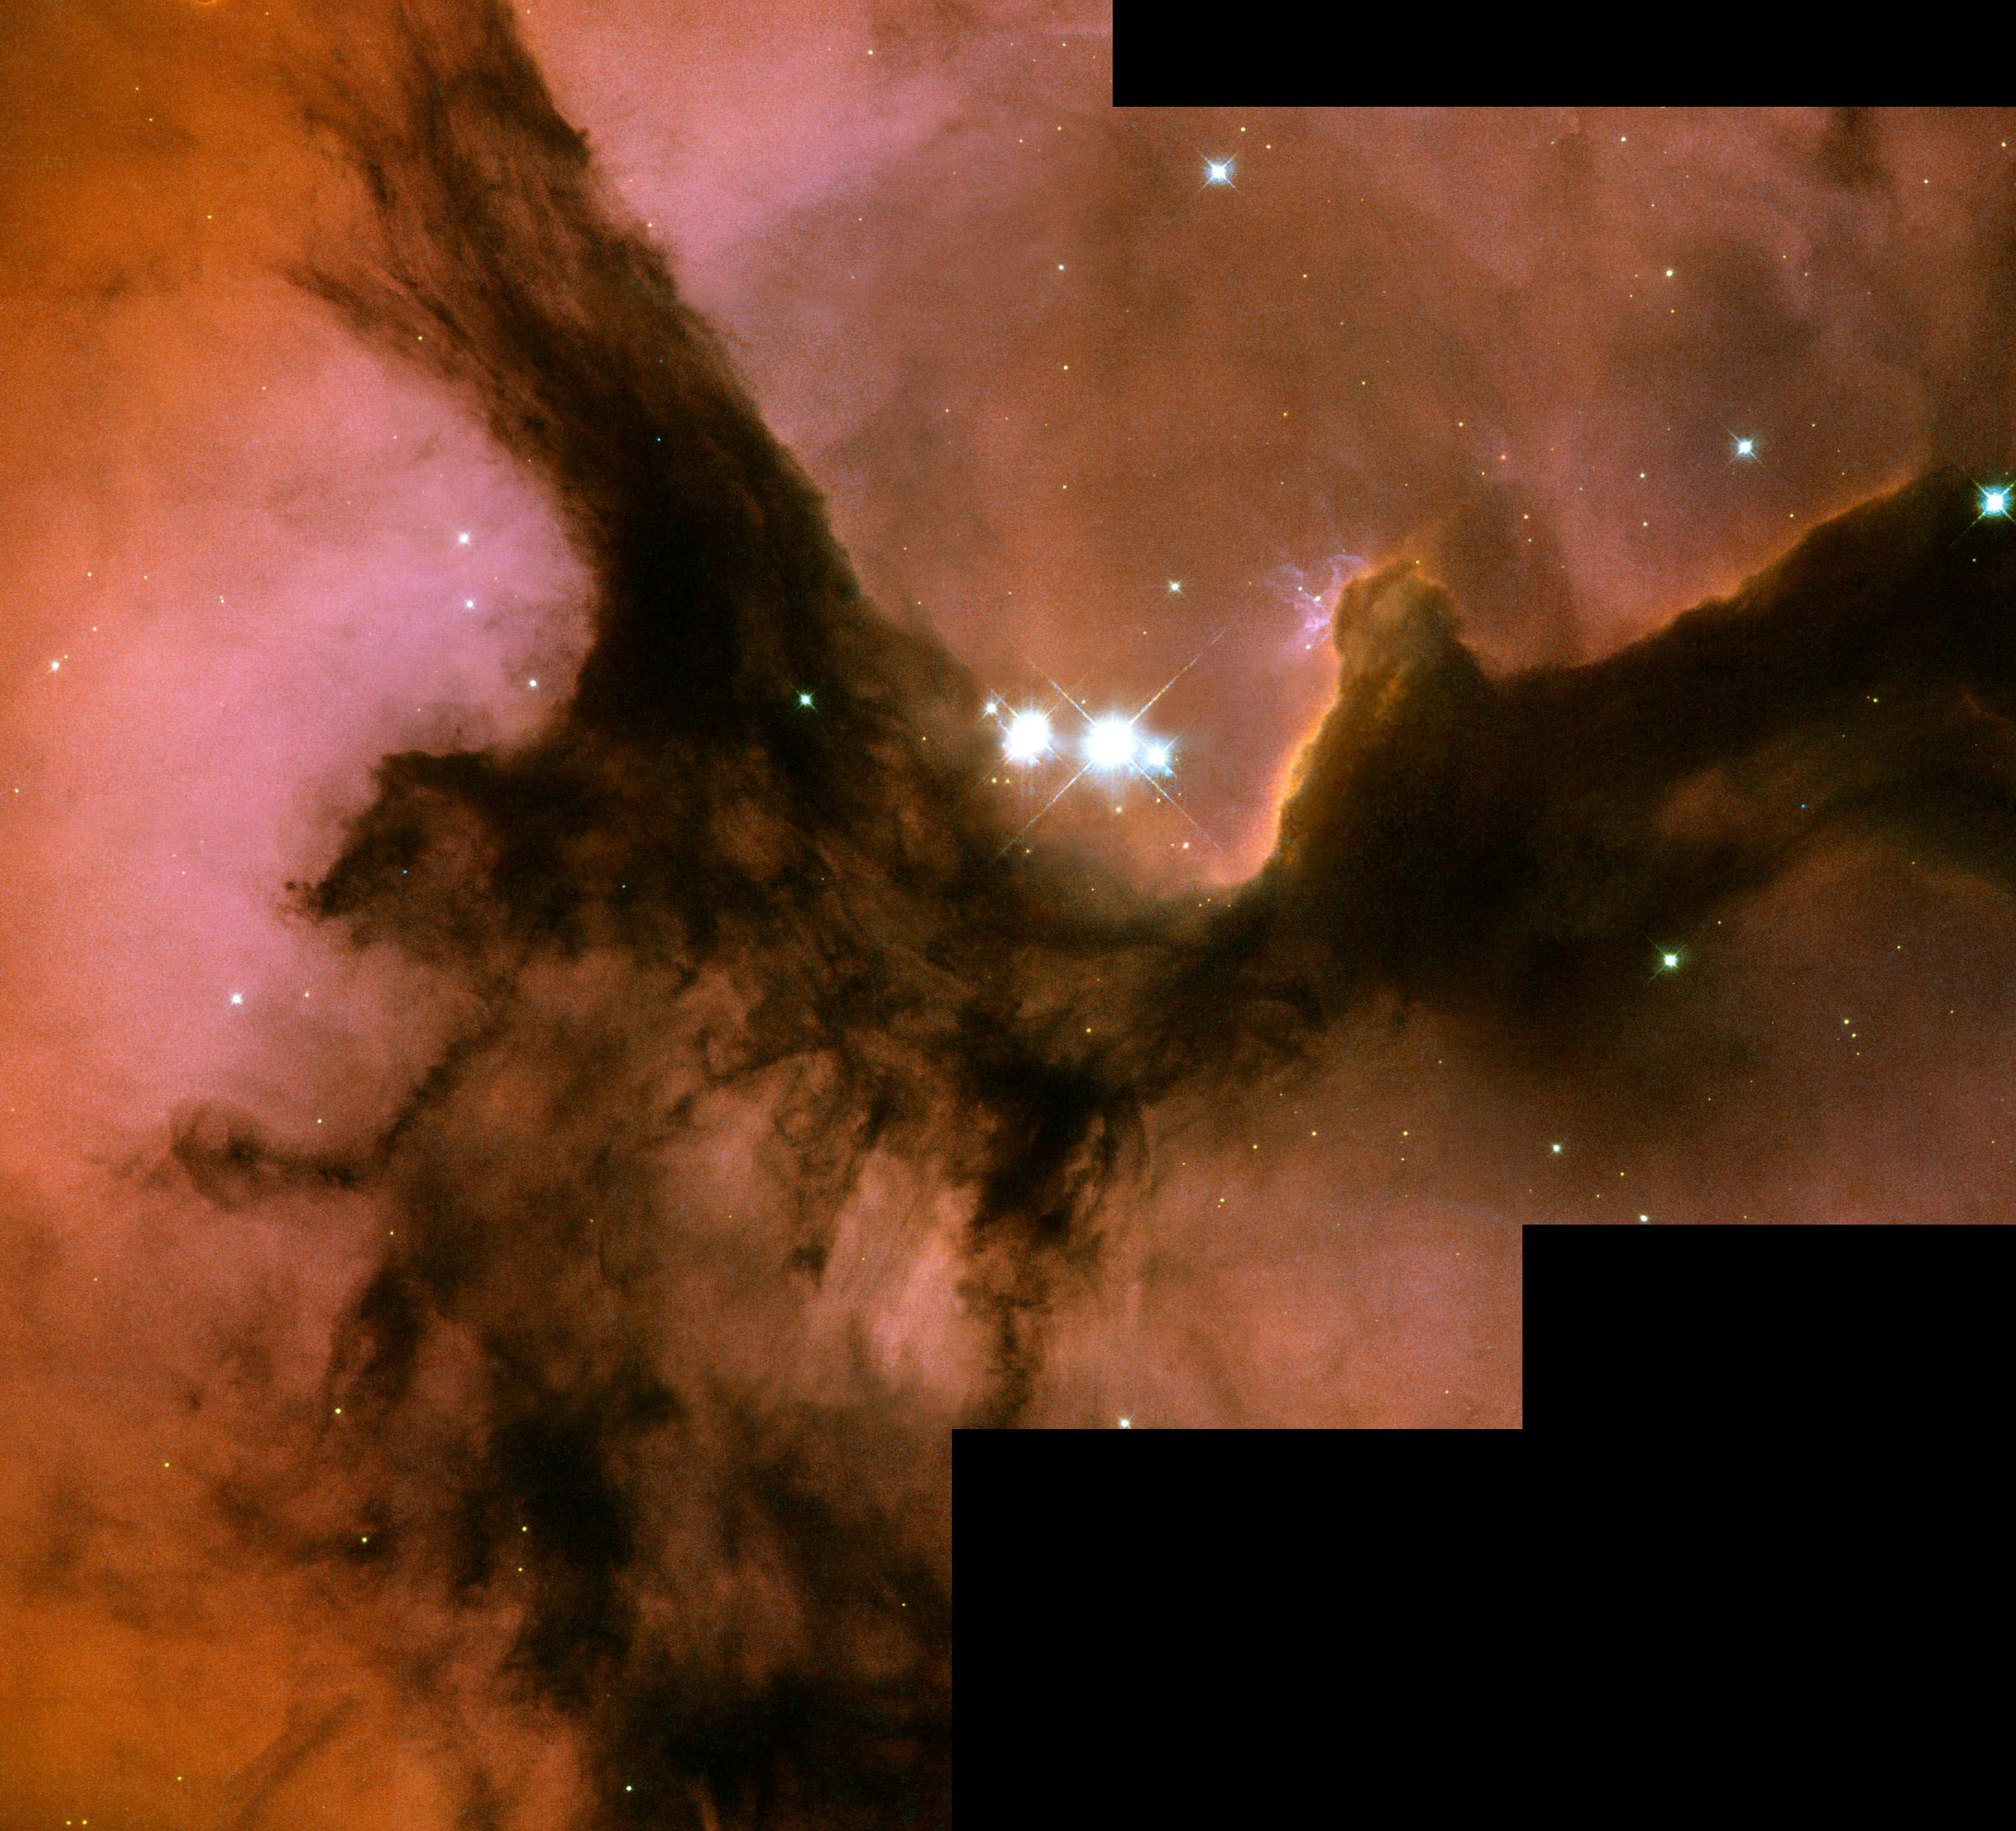
Rising Above the Atmosphere

Slide 4
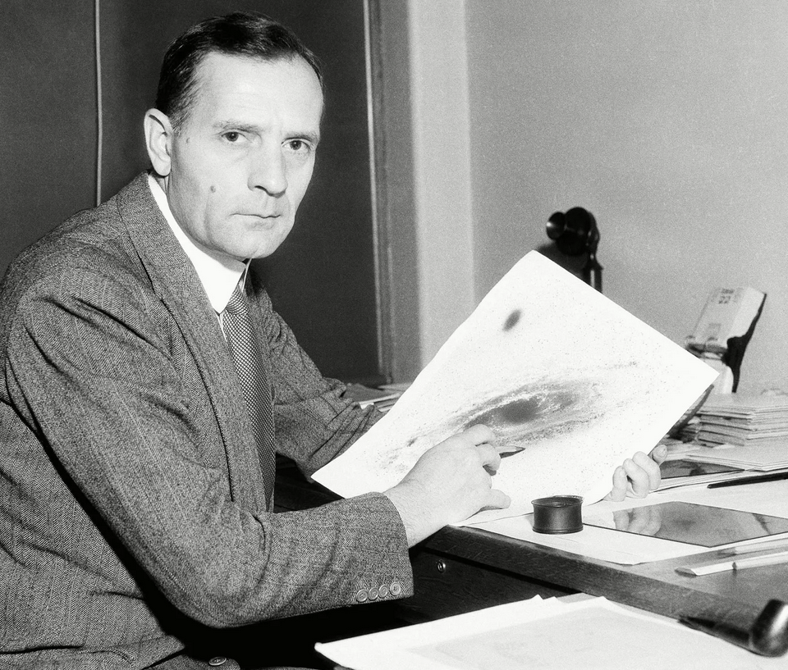
The Namesake: Edwin Hubble

Slide 5
Why was Hubble famous?
Edwin Hubble is known for discovering the universe is expanding - galaxies are moving away from us at a rate proportional to their distance, called "Hubble's Law"; he also proved Andromeda Nebula is separate galaxy beyond the Milky Way, by identifying Cepheid variable stars within it, using the “standard candle” approach developed by Henrietta Leavitt

Slide 6
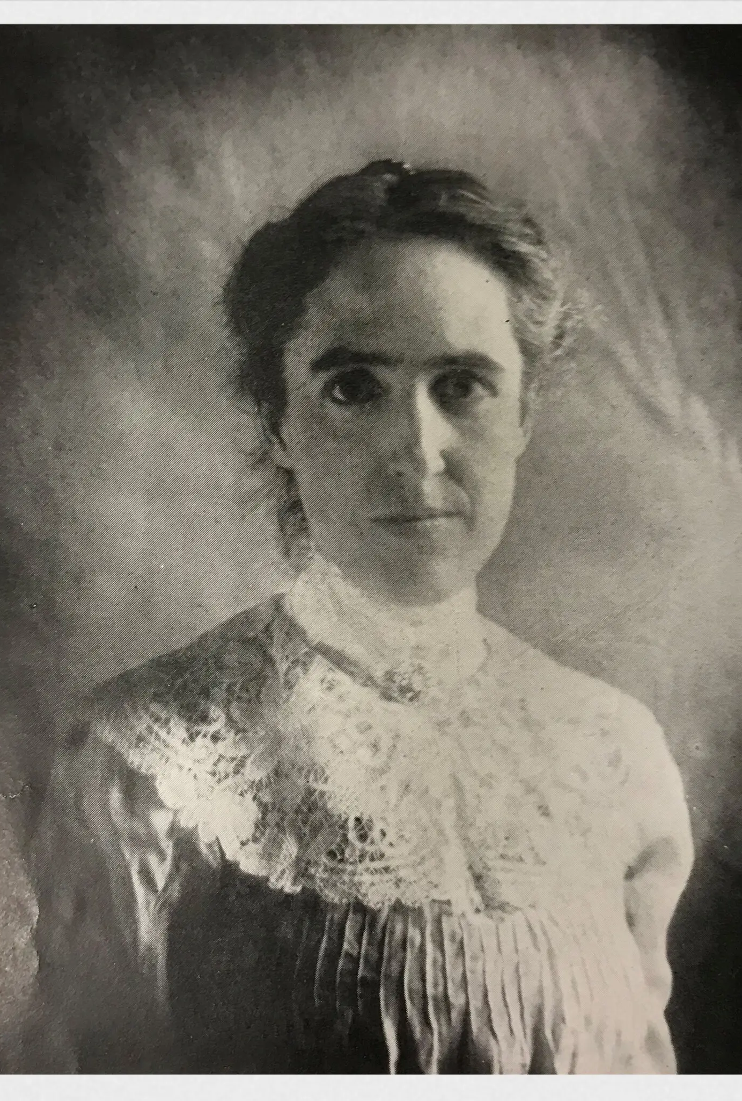
Henrietta Leavitt determined the “standard candle” theory at Harvard

Slide 7
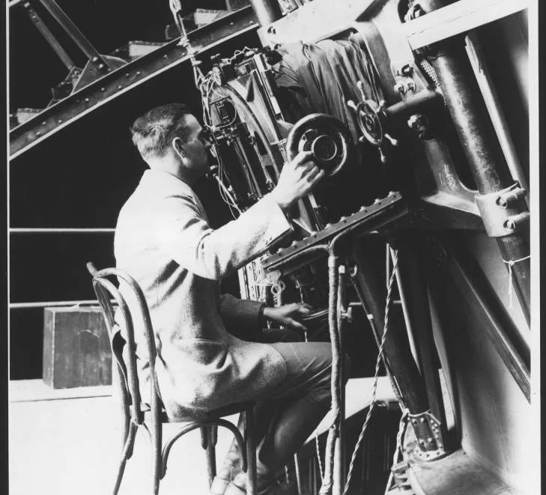
Hubble made New Discoveries with the Hale (Hooker) 100” at Mount Wilson

Slide 8
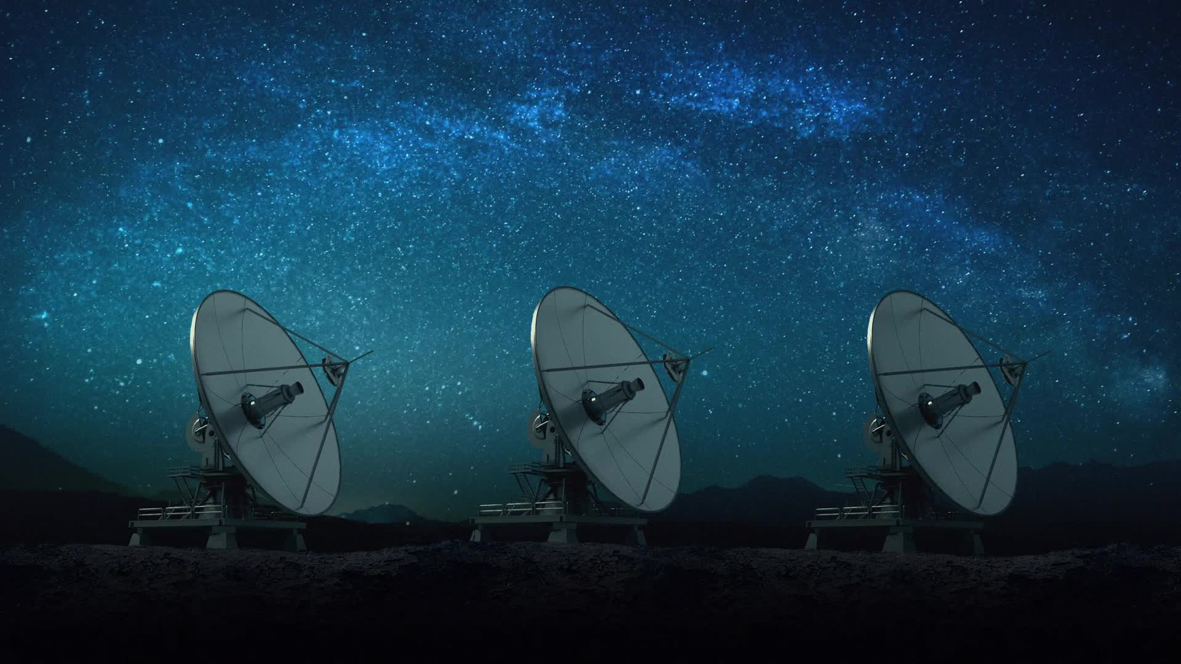
Previous Space Telescopes

Slide 9
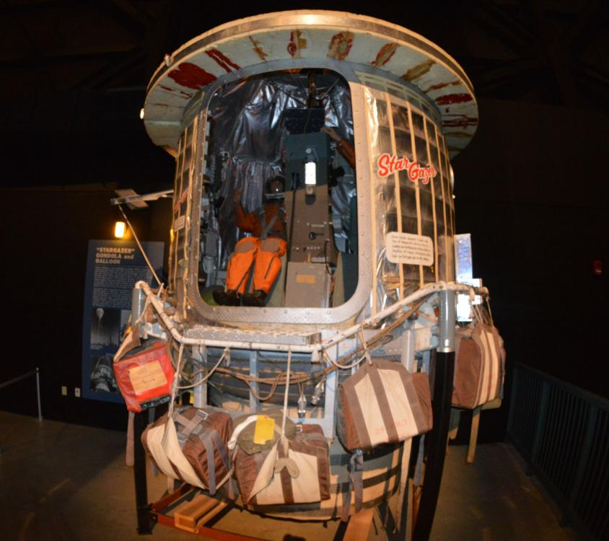
Operation Stargazer: A U.S. Air Force mission that used a 12.5-inch reflecting telescope and high-altitude balloons to take images. The mission launched in 1962

Slide 10
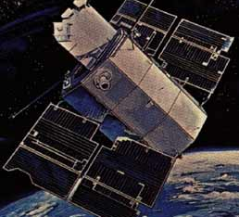
Orbiting Astronomical Observatory (OAO-2): The first space telescope, launched in 1968.

Slide 11
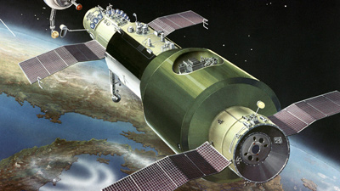
Soviet Orion 1: An ultraviolet telescope launched in 1971 aboard the space station Salyut 1.

Slide 12
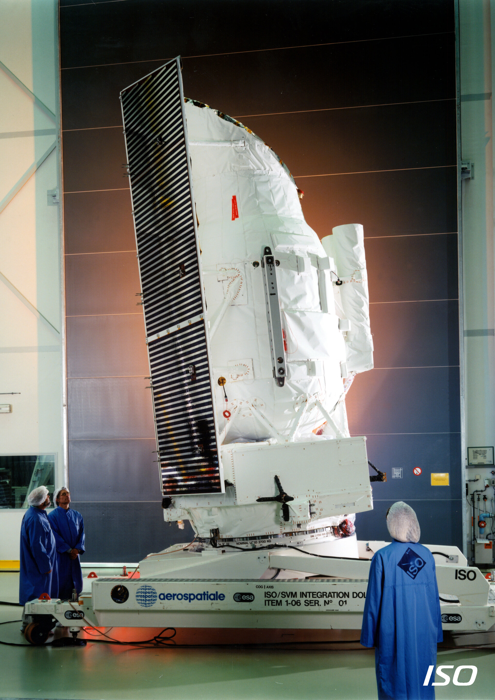
Infrared Space Observatory (ISO): Launched in 1995 with an aperture of 0.60 m.

Slide 13
Delays and Costs
The Hubble Space Telescope's launch was delayed several times, including due to the Challenger disaster and software issues
As with all NASA projects in the 70s and 80s, what small budget there was went to developing the Shuttle and planetary exploration
There was a real push after the end of Apollo to have reusable spacecraft to lower costs, much as we see now with SpaceX

Slide 14
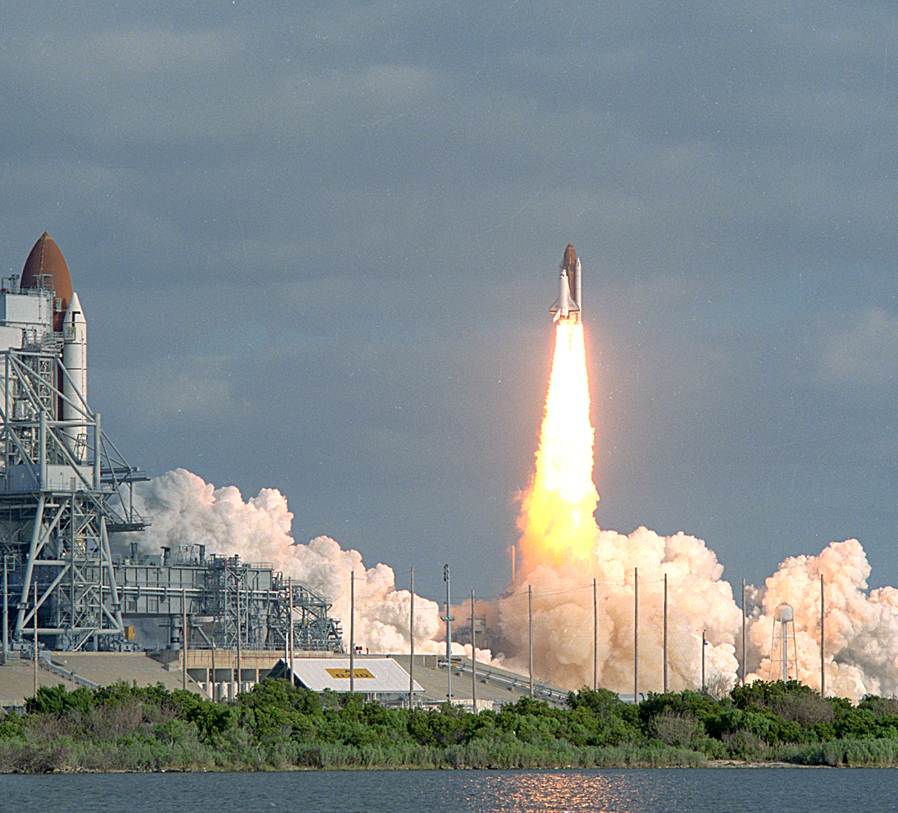
Finally, in 1990…the spacecraft launches on STS-31 (Discovery)

Slide 15
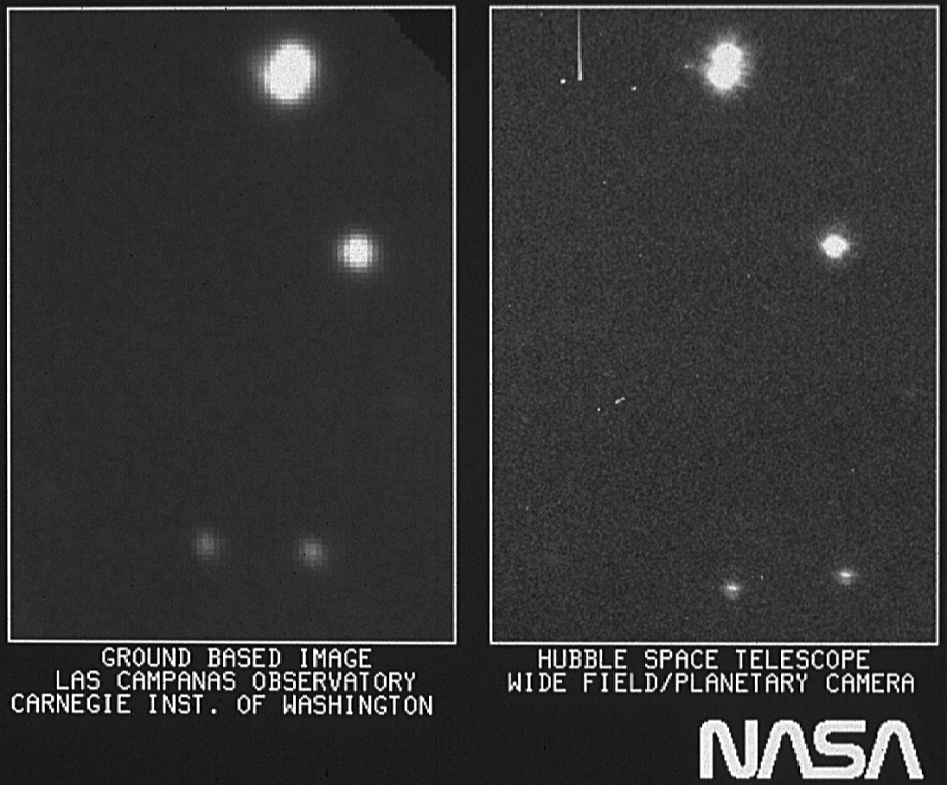
Initial Images are Aberrated

Slide 16
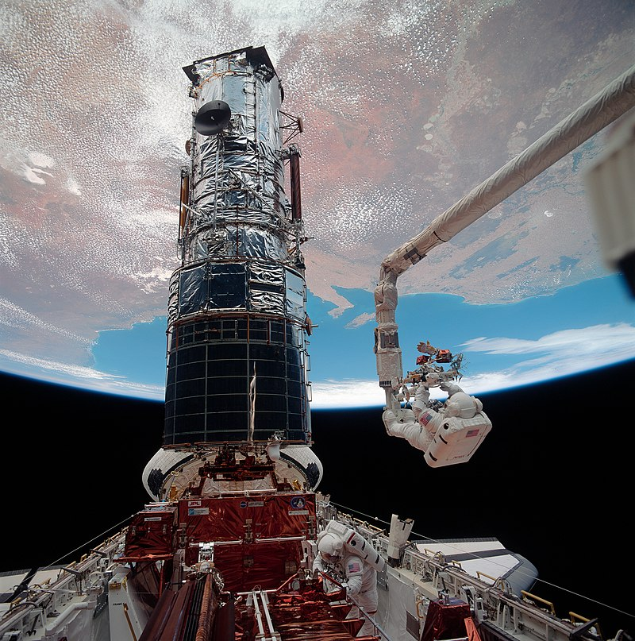
Rescue Mission Launched STS-61 (Endeavour)

Slide 17
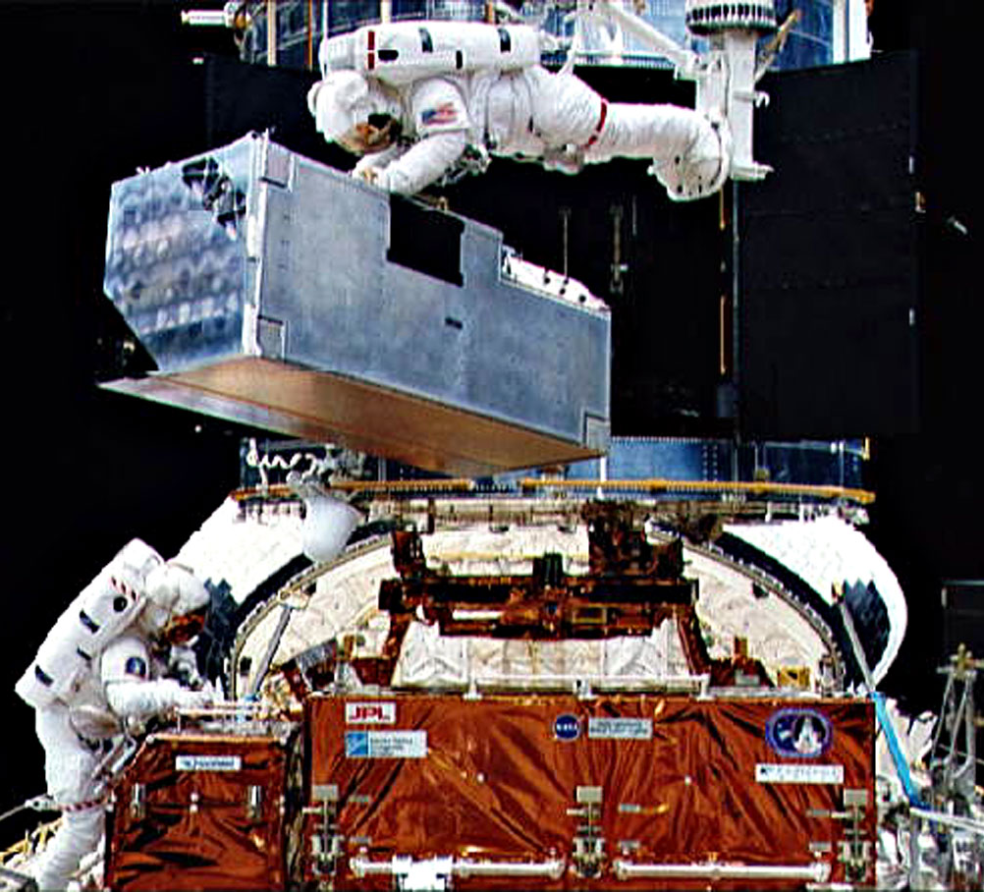
COSTAR corrective optics were installed

Slide 18
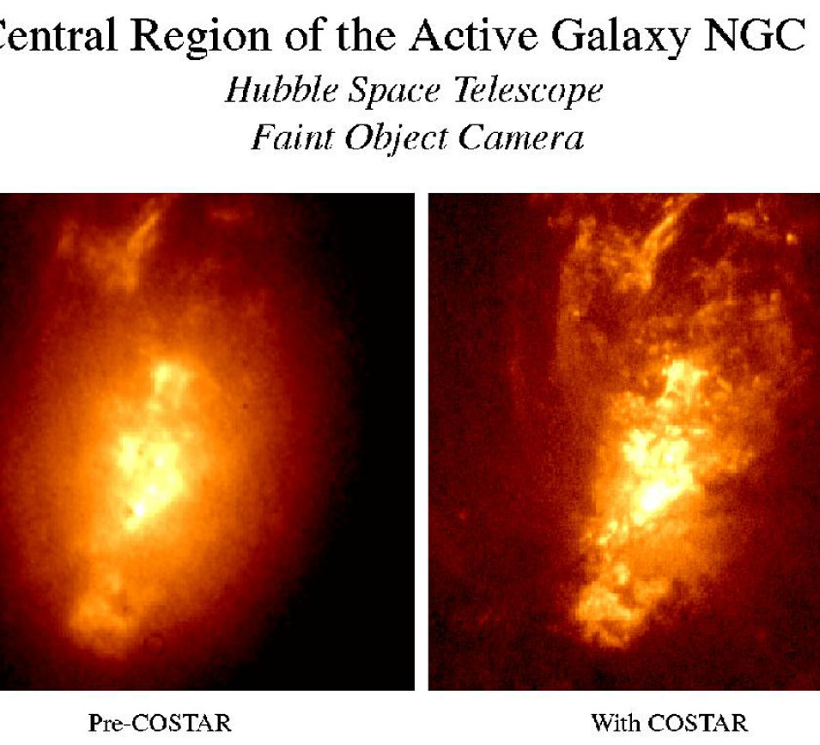
Test images taken and 4 more missions

Slide 19
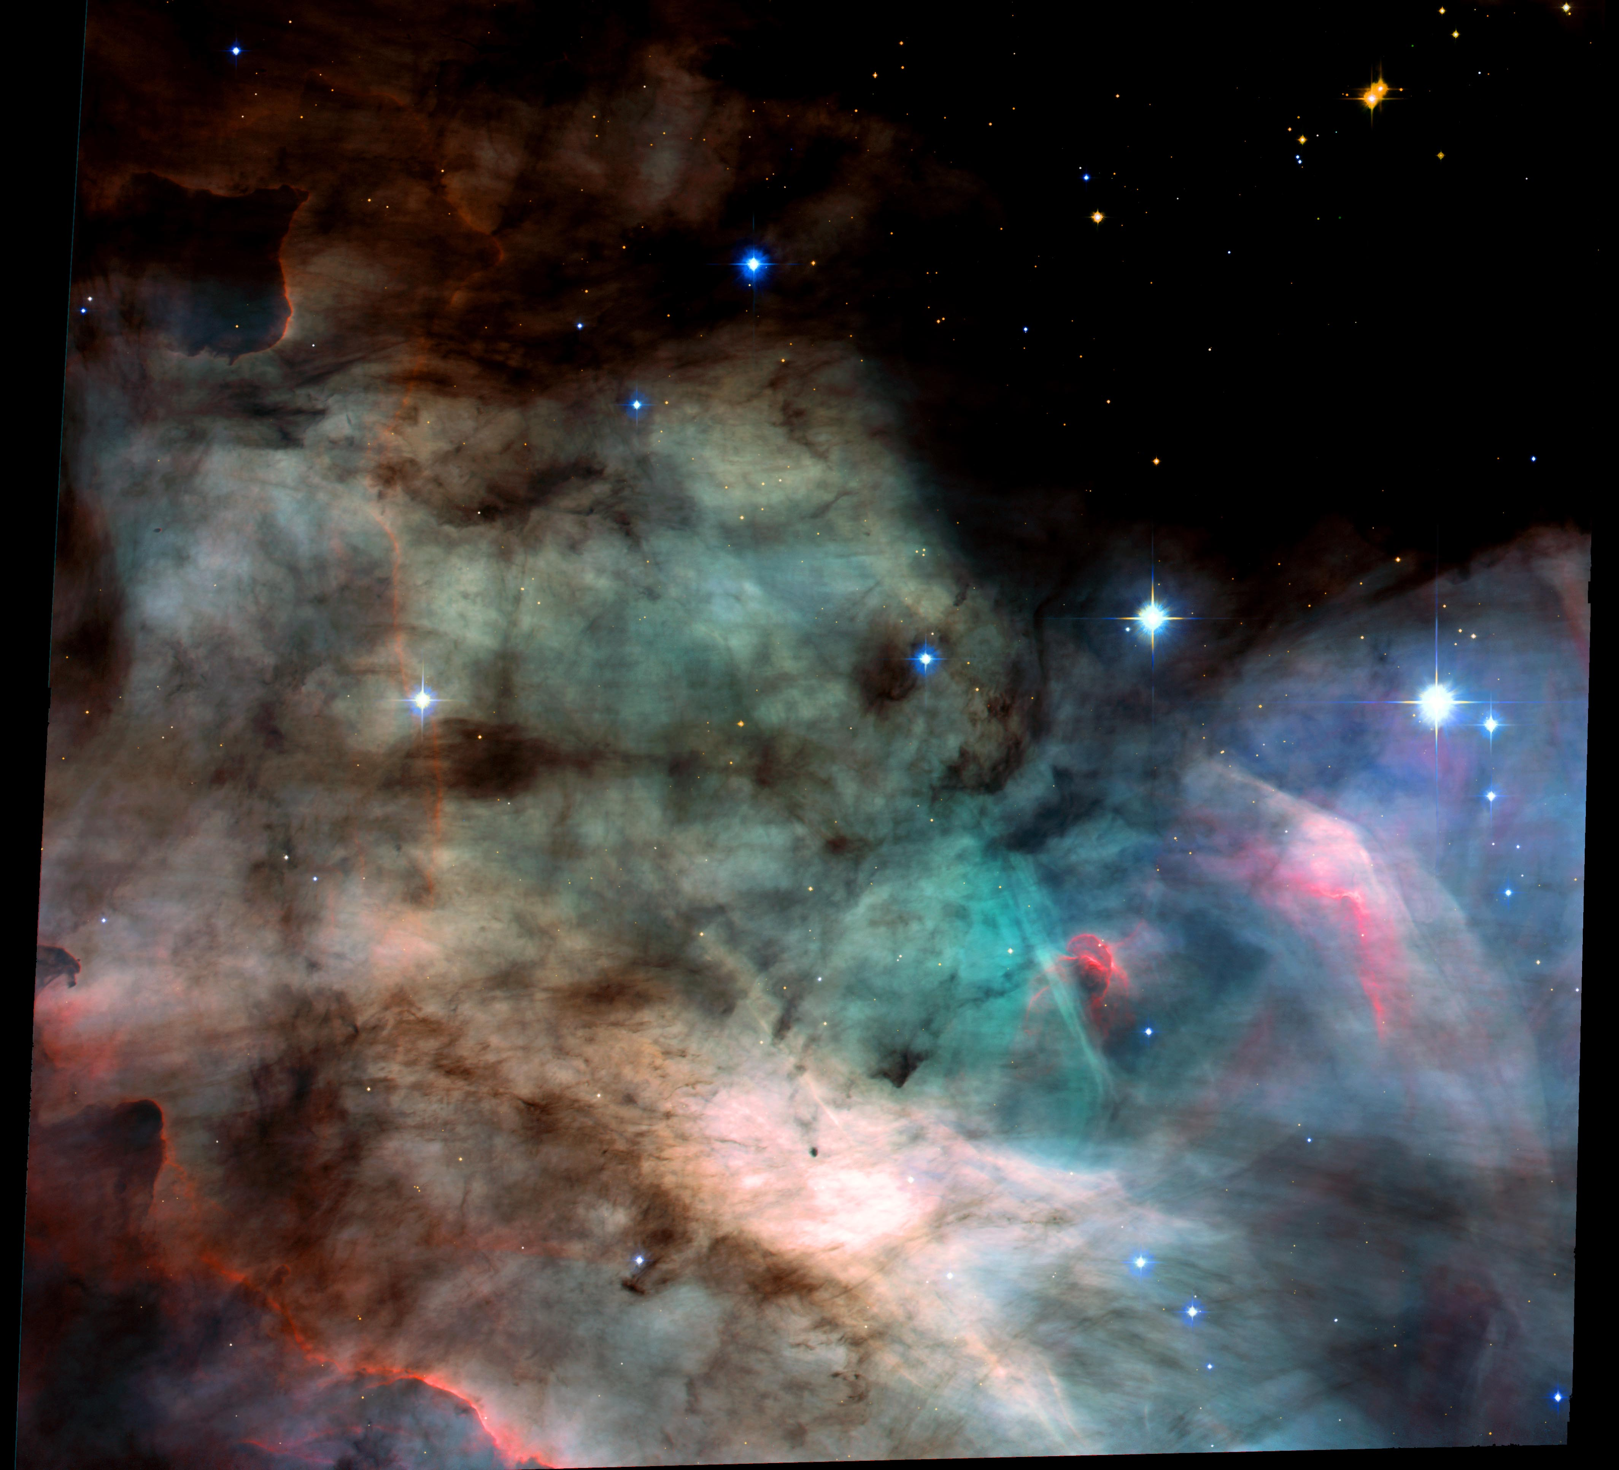
Success! New Images Astound

Slide 20
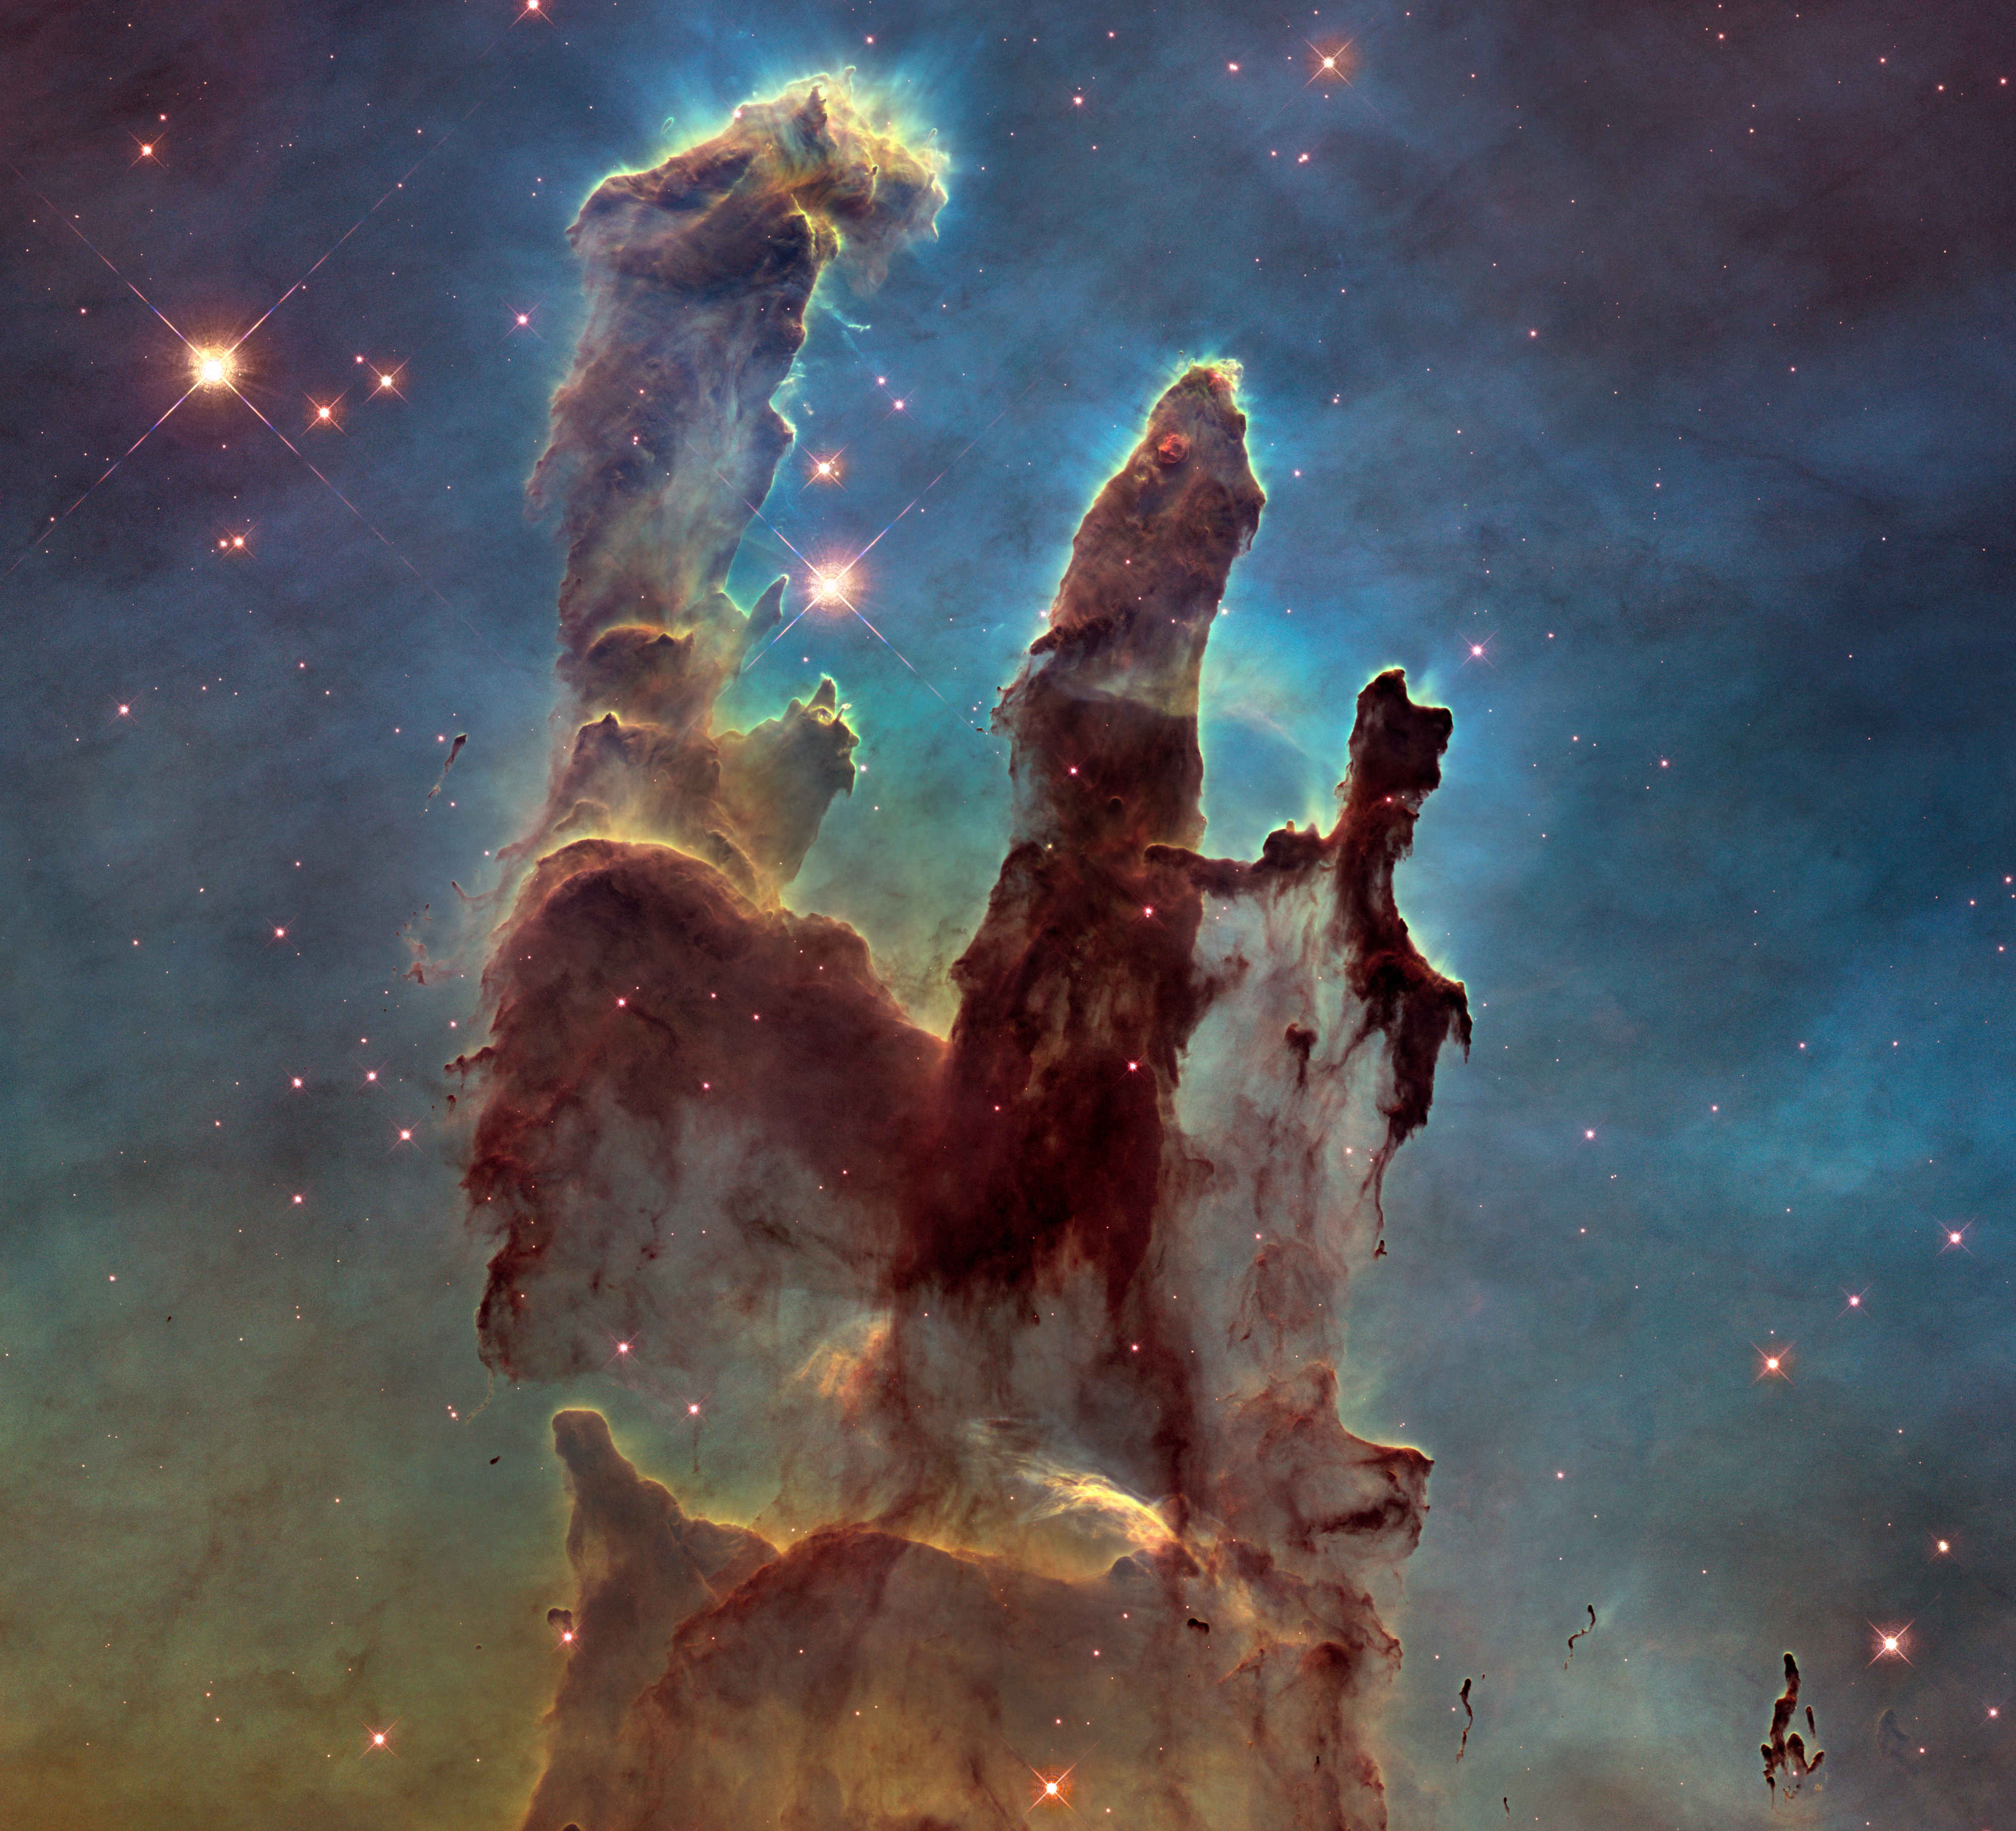
Pillars of Creation

Slide 21
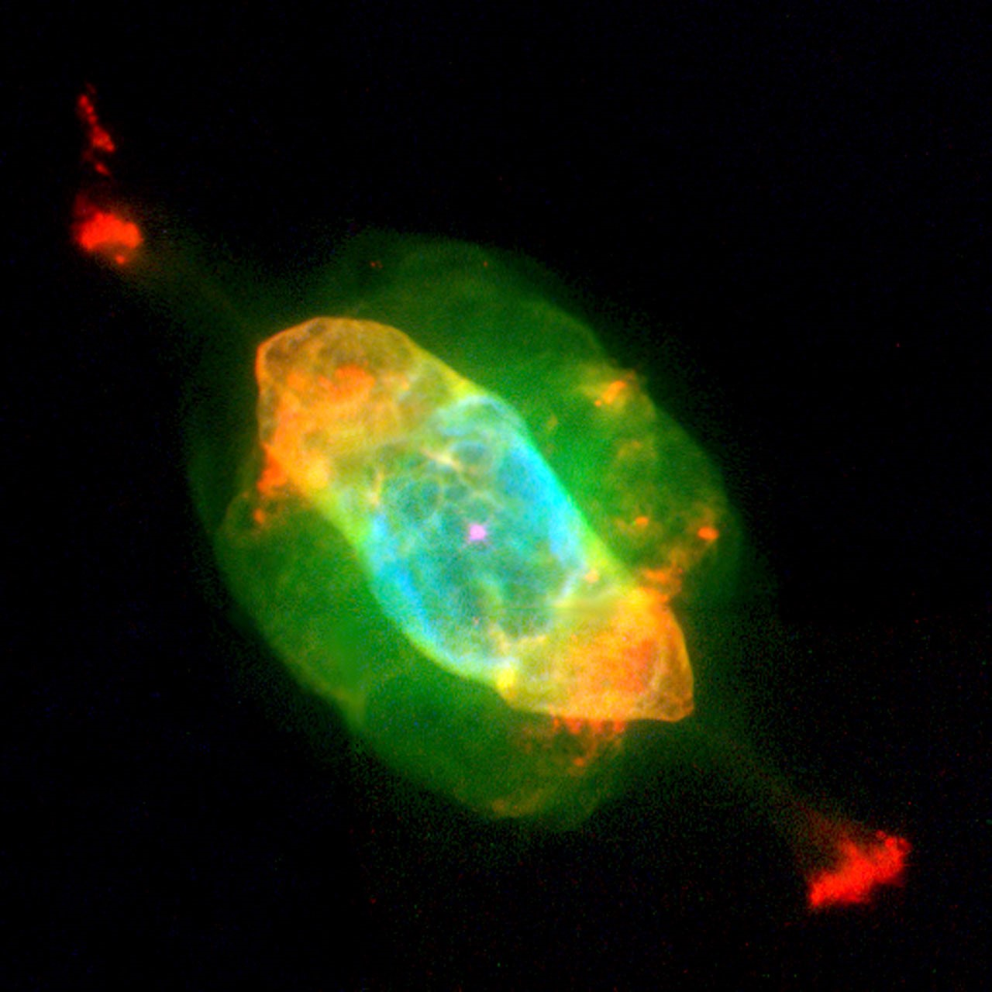
More Images Fuel Public Interest

Slide 22
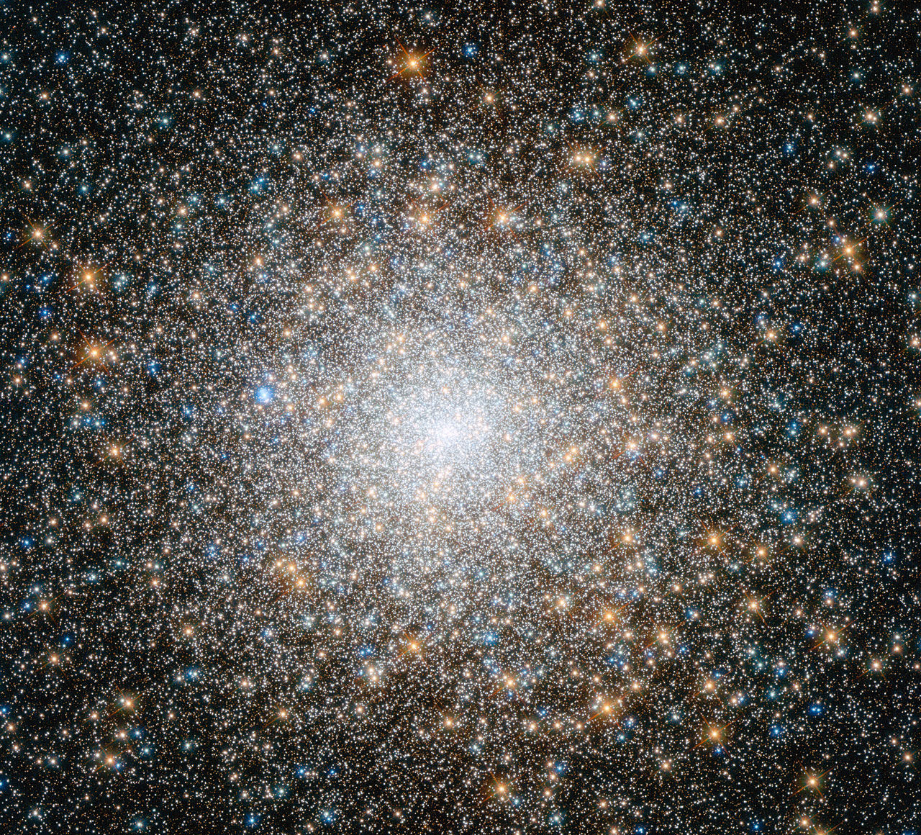
Science Findings Increase

Slide 23
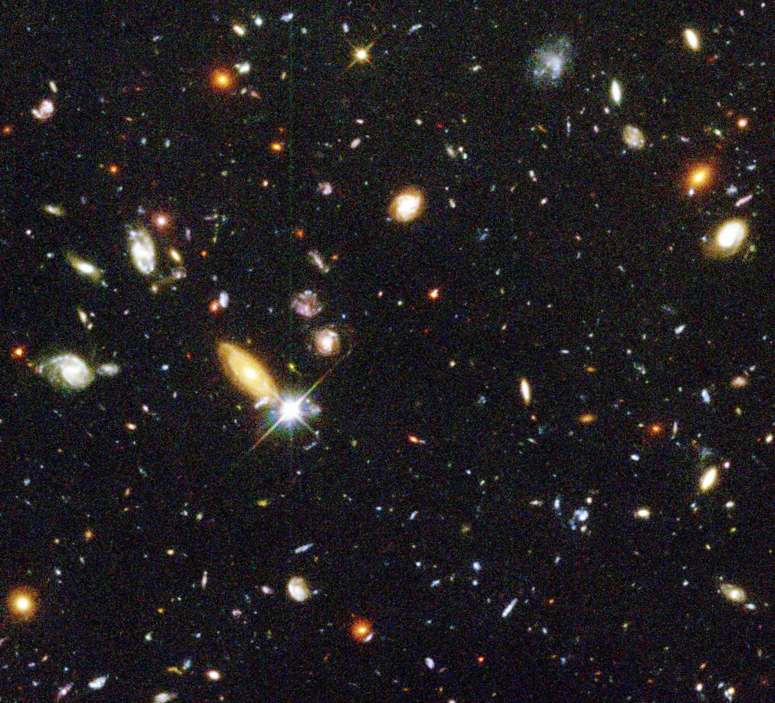
Hubble Deep Field

Slide 24
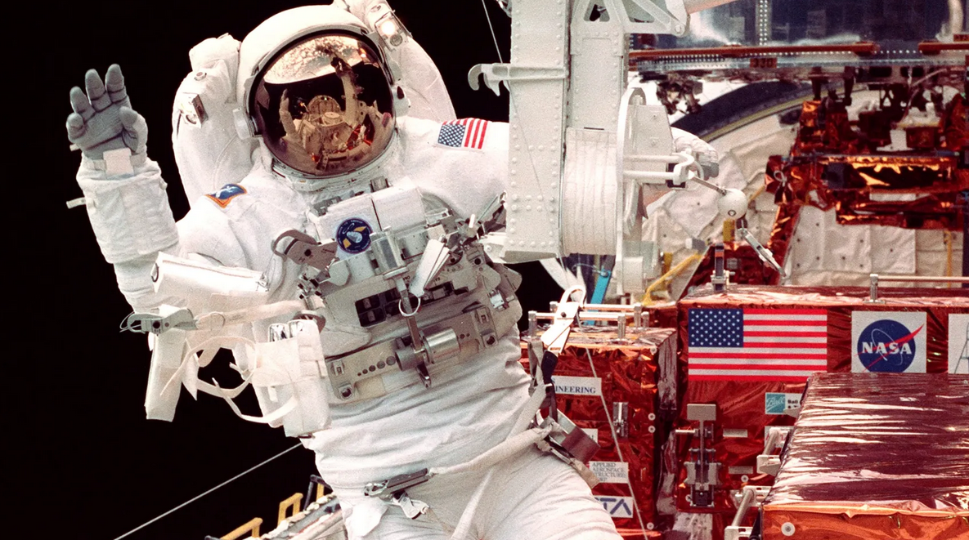
Servicing Missions

Slide 25
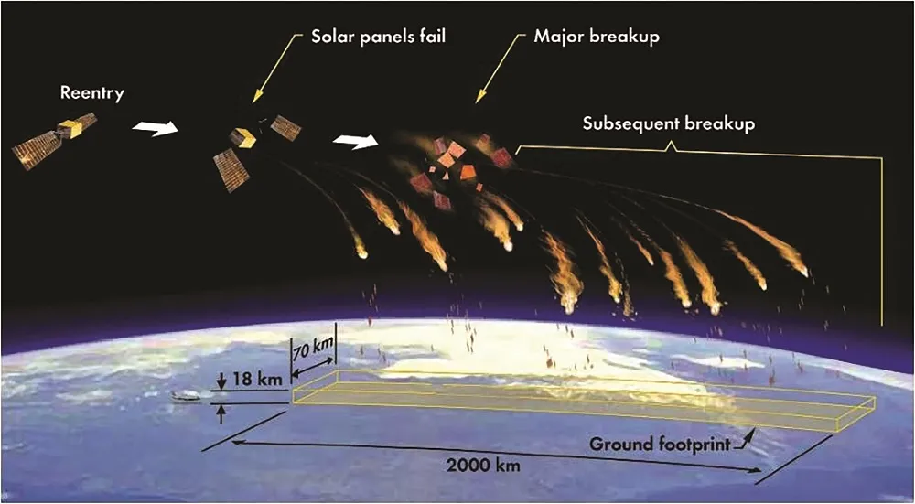
Future of Hubble (mid 2030’s)

Slide 26
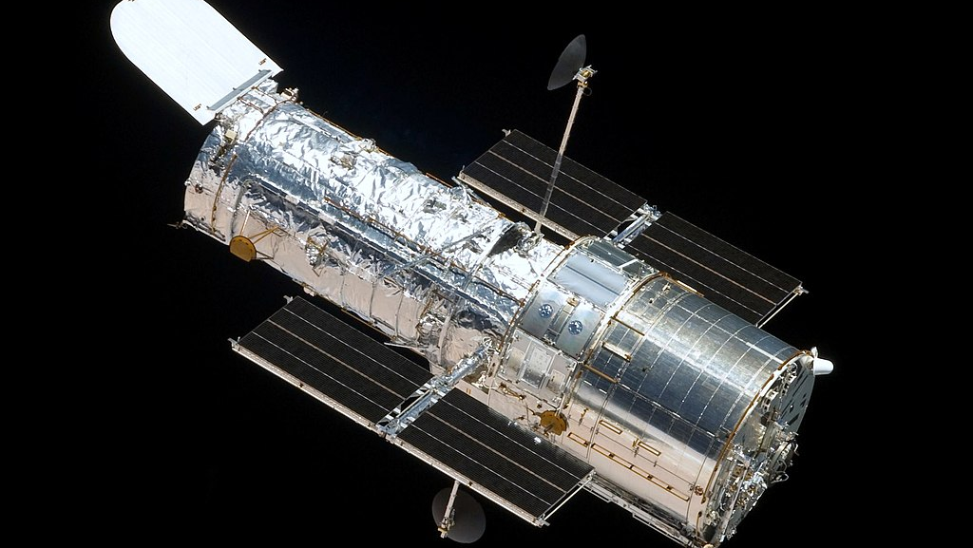
Celebrate 35th Anniversary 2025

Slide 27
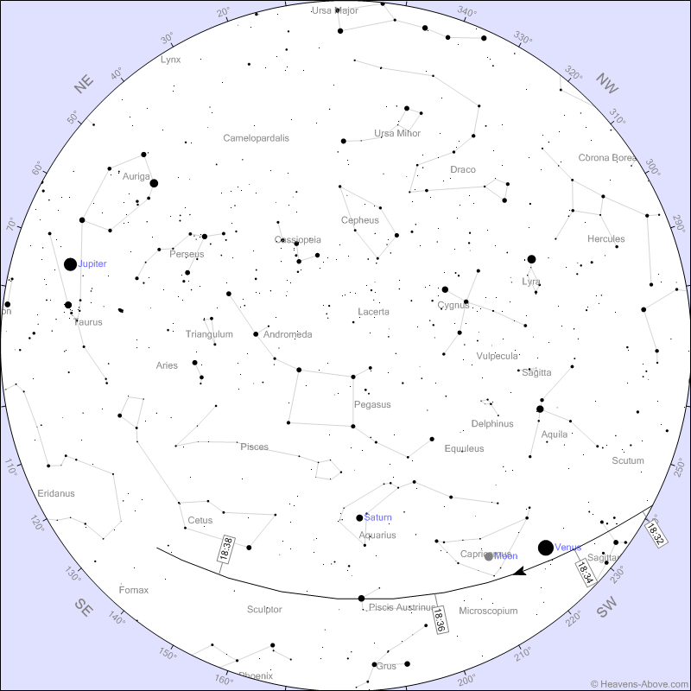
You can see HST in the South

Slide 28
Astronomical League Program
https://www.astroleague.org/nasa-observing-challenges-special-awards/

Slide 29
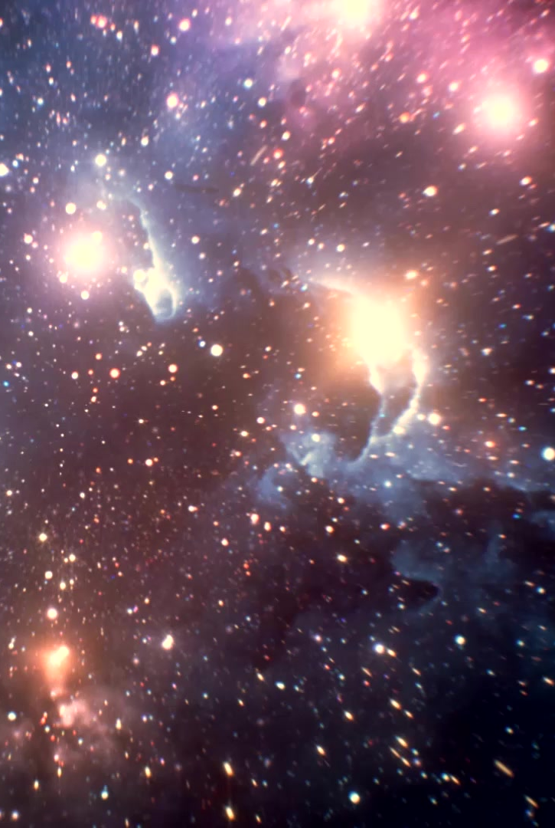
Next Time
More in-depth on the effect of Hubble on the public perception of astronomy. SPOILER: It was enormous.

Slide 30
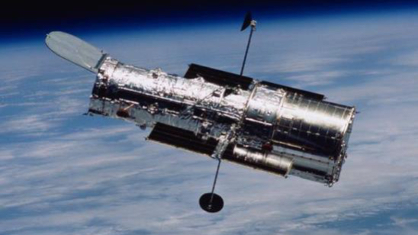
Thank You!

