Slide 1
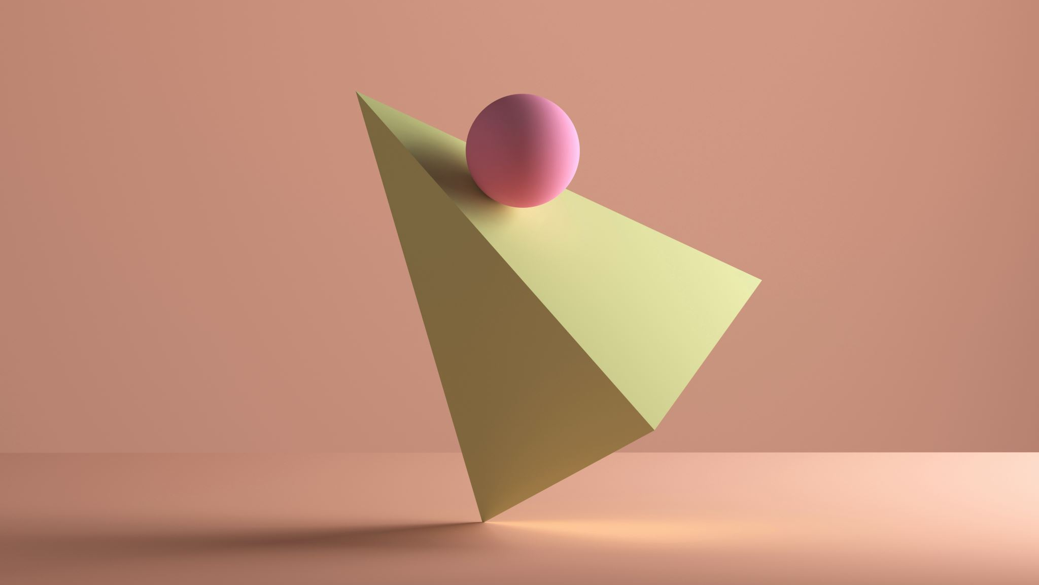
OBSERVING SESSION 6
Trainsitioning
Brad Young
Observing Chair, Astronomy Club of Tulsa

Slide 2


Solar Eclipse Observing Challenges

Slide 3
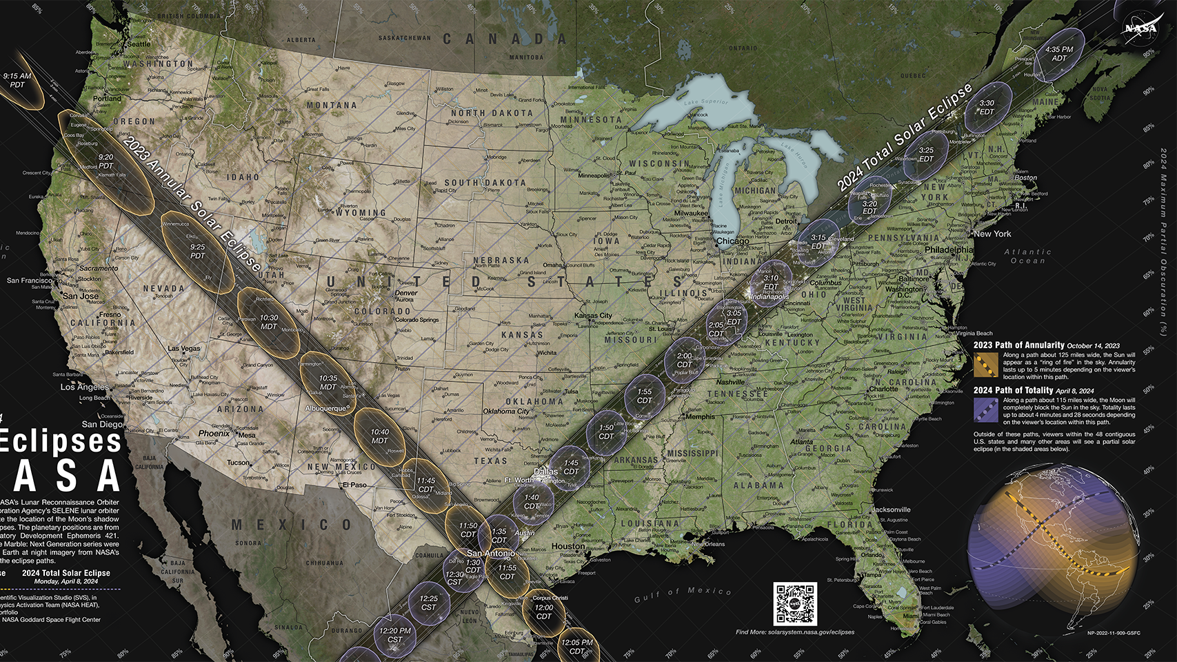

Slide 4
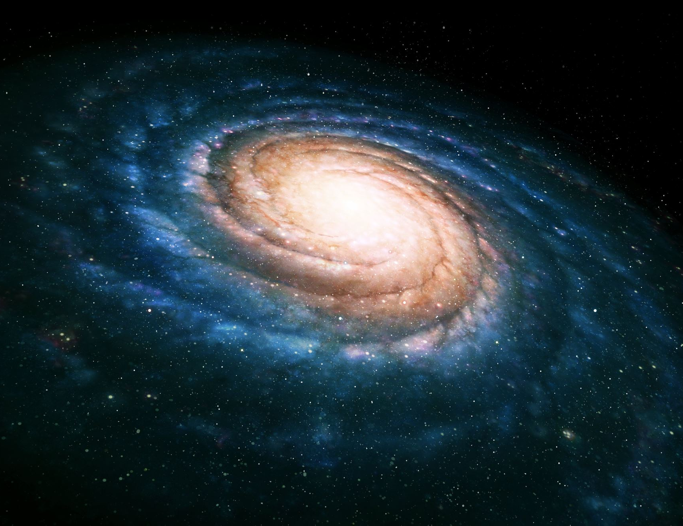
Trainsitioning
FROM WINTER TO SPRING DEEP SKY OBJECTS
Winter = galactic objects
  open clusters
  reflection nebula.
Spring = leave Milky Way
  other galaxies
Changes:
  eyepiece, filters, etc.,
  training our eyes

Slide 5
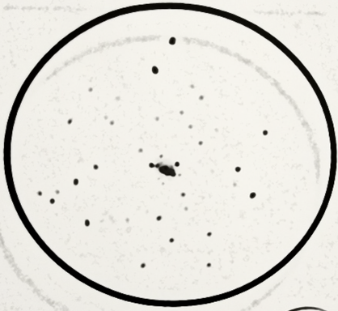
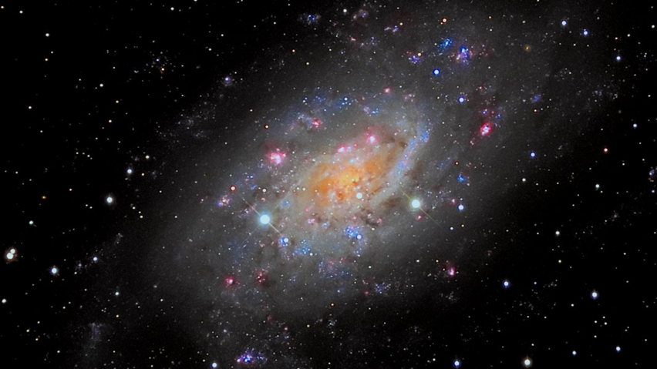
COMPARING WINTER TO SPRING OBJECTS
Caldwell 7 (NGC 2403)
ETX-125 47x

Slide 6
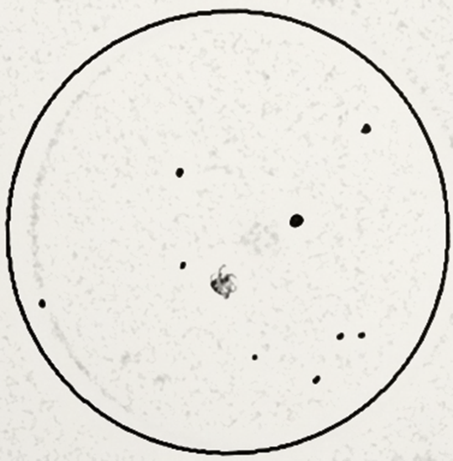
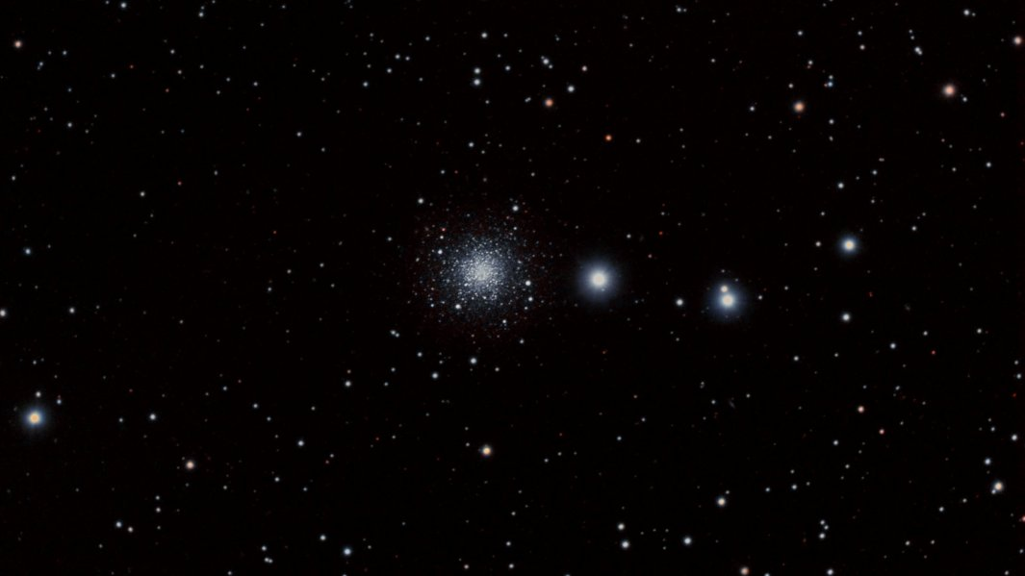
COMPARING WINTER TO SPRING OBJECTS
Caldwell 25 (NGC 2419)
ETX-125 153x

Slide 7
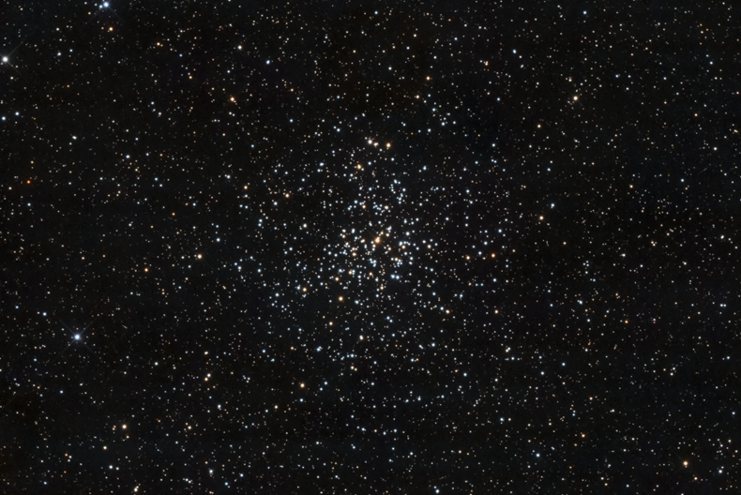
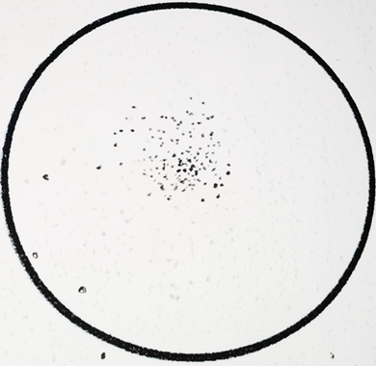
COMPARING WINTER TO SPRING OBJECTS
Messier 37
ETX-125 47x

Slide 8
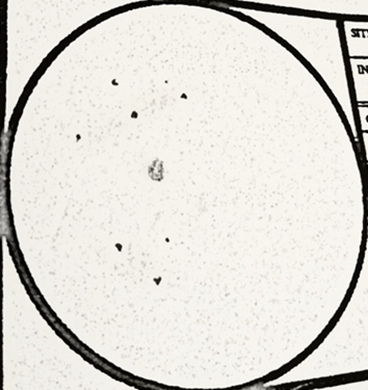
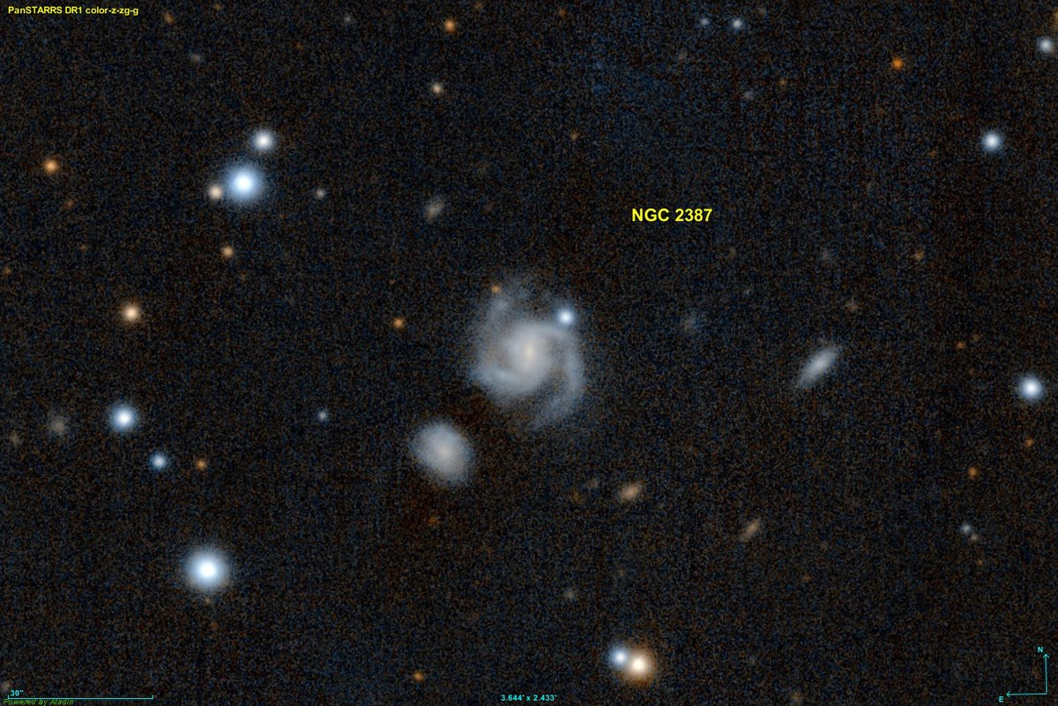
COMPARING WINTER TO SPRING OBJECTS
NGC 2387
Note 2 galaxies I thought were field stars!

Slide 9


WHAT DO WE NEED TO DO to trainsition?
WINTER OBJECTS BRIGHT / LARGE
THEY MAY SOMETIMES BE RESOLVED
WIDE FIELD IMAGE OR EYEPIECE OK
SPRING DSO FAINTER / SMALLER
INCREASE POWER FOR HI CONTRAST
AVERTED VISION - “SHADES OF GREY”

Slide 10
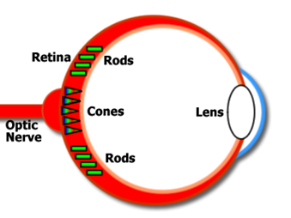
ASTRONOMER’S EYE
CONES ARE THE RGB SYSTEM – LONGER SUBS
RODS ARE LUMINANCE ONLY / MORE SENSITIVE
CONES NEAR CENTER
RODS SURROUND CONES OFF-AXIS OF RETINA

Slide 11
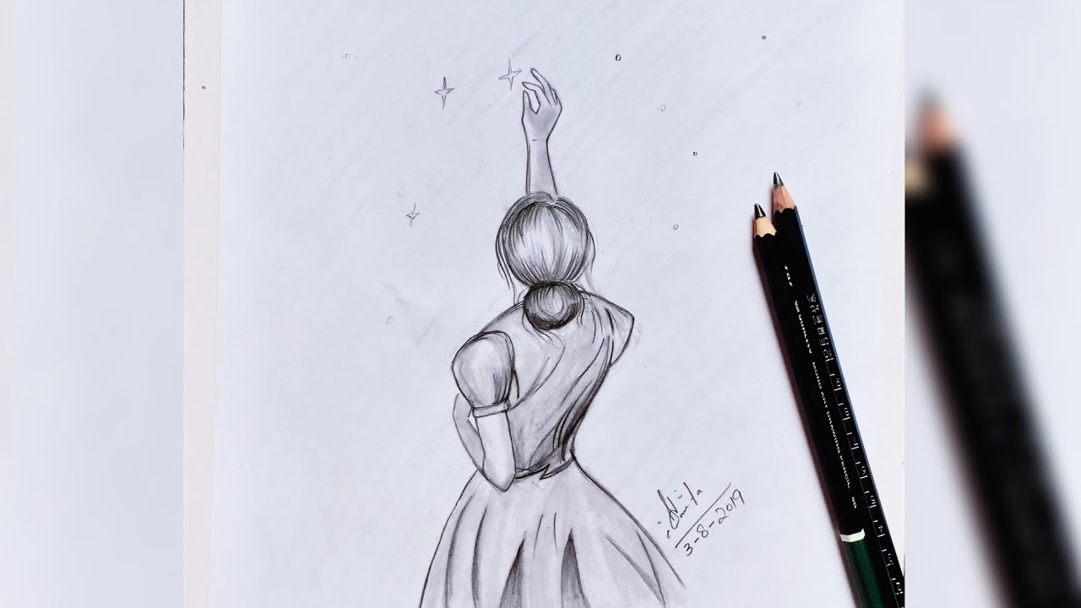
SKETCHING

Slide 12
ASTRONOMICAL SKETCHING
If you don’t image, best way to record memories
You can still have observing notes or journal
Makes you stop and look at the object.
Not necessary to be artistic; can be private
Capture info for use later:
  Pattern of field stars for star hopping
  Unique feature or memorable detail
  Draw and describe differences due to power, filters, AV, etc.

Slide 13
AL Observing Challenge #8 Galaxies 2.0

Slide 14
OBSERVING SESSION 6
THANK YOU
DON’T FORGET:
MERCURY VENUS AND MARS IN EVENING SKY
LYRID METEORS PEAK AROUND 4/23
LAST LOOK AT ORION
GALAXIES ON PARADE
Brad Young
Observing Chair, Astronomy Club of Tulsa

